Slide 2
Sketching in Spacemaker

Slide 3
Analysis of apartment sizes

Slide 4
Analysis of sun conditions

Slide 5
Analysis of wind conditions

Slide 6
Select and browse different concepts according to priority of different criteria

Slide 7
Optimisation with AI

Slide 8
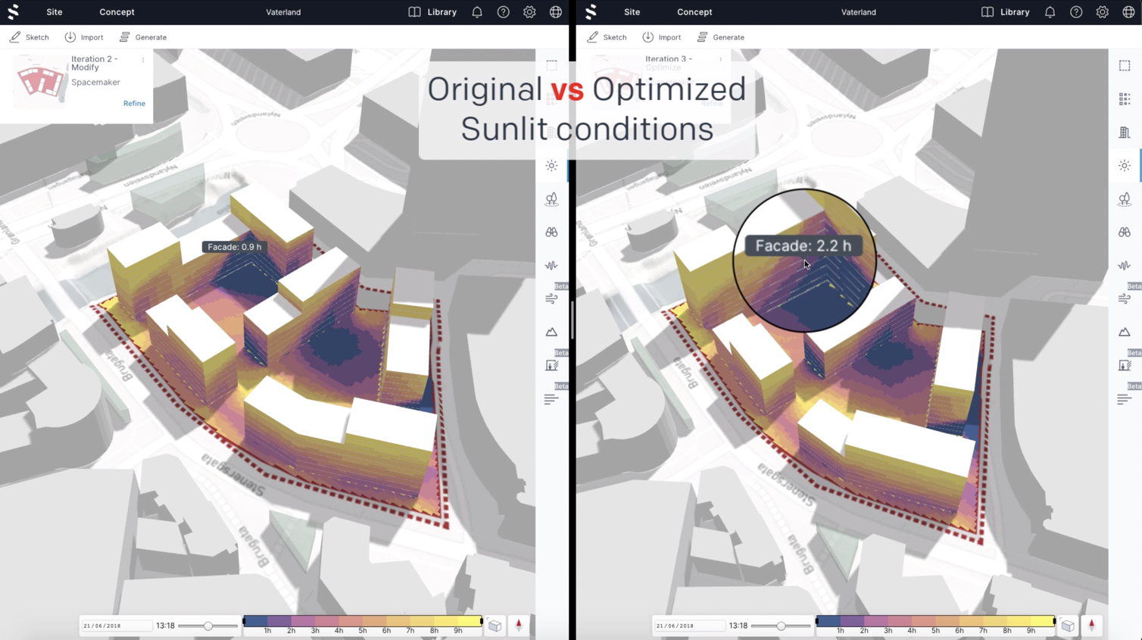
Comparison between original concept and the concept optimized with Spacemaker

Slide 9
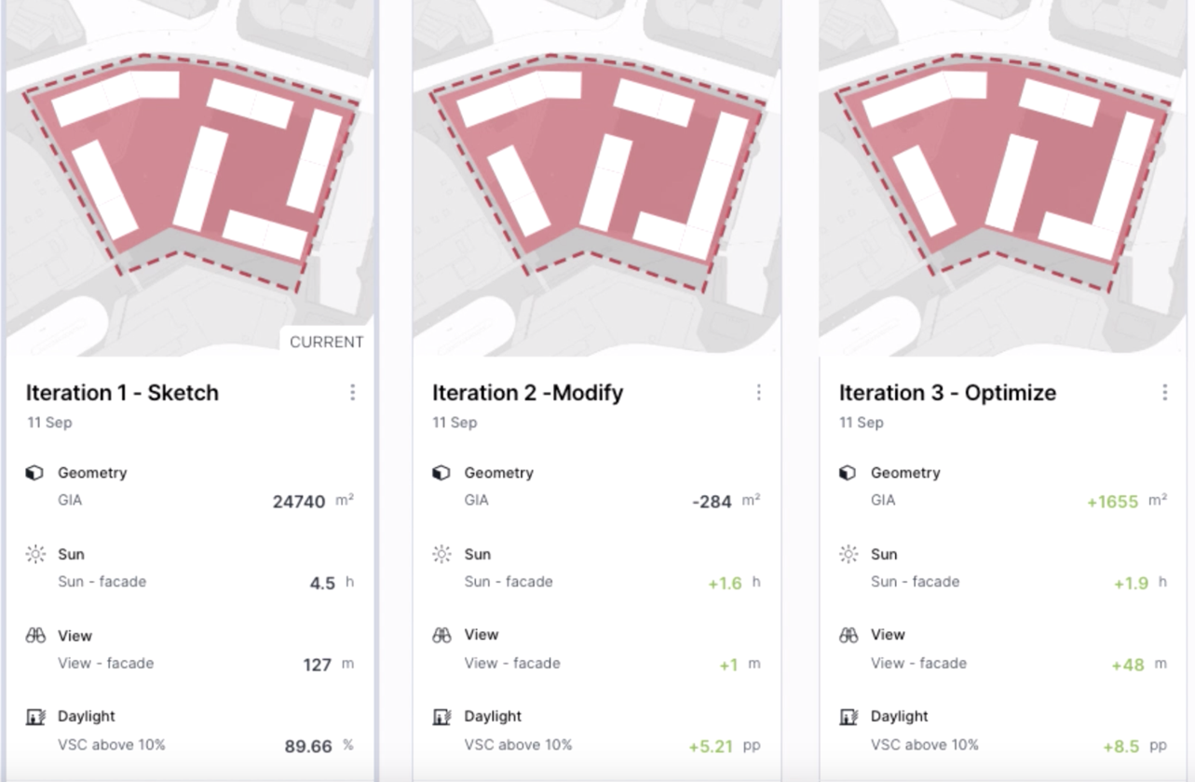
Comparison of concept evolution in Spacemaker

